Slide 1

structured internship program in marketing
Submitted to:- Shashwat Singhal
Submitted by:- Unnati Chaurasia

Slide 2
INTRODUCTION TO
MARKETING ORGANIZATION
A marketing organization is a business or department that focuses on identifying customer needs and promoting products or services to satisfy those needs. It is responsible for creating awareness about a company's offerings, attracting customers, and building long-term relationships with them. Marketing organizations use various strategies such as advertising, digital marketing, branding, market research, and customer engagement to achieve business goals.
In today's competitive business environment, marketing organizations play a vital role in increasing sales, improving brand value, and helping companies adapt to changing consumer preferences. They work closely with customers to understand market trends and develop effective marketing campaigns that drive business growth.

Slide 3
WHAT IS A MARKETING ORGANIZATION?
A marketing organization is a company or department that promotes and sells products or services by understanding customer needs and creating effective marketing strategies. Its main objective is to attract customers, increase sales, and build a strong brand image.
Types of Marketing Organizations
Digital Marketing Agencies
  Provide services like SEO, social media marketing, content marketing, and online advertising to help businesses grow digitally.
FMCG (Fast-Moving Consumer Goods) Companies
  Market everyday consumer products such as food, beverages, and personal care items through advertising and promotional activities.
E-commerce Businesses
  Sell products and services online using digital marketing, customer analytics, and promotional campaigns.

Slide 4
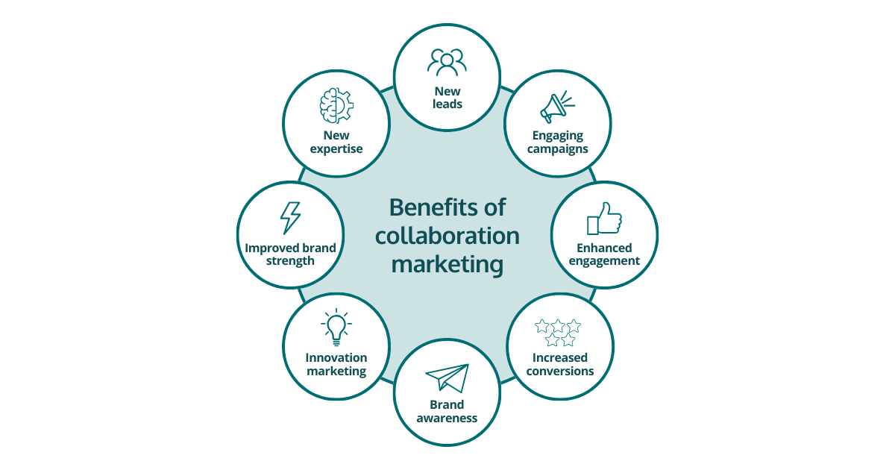
BENEFITS FOR ORGANIZATIONS
Fresh Ideas and Creativity
  Interns bring new perspectives and innovative ideas that can improve marketing strategies and campaigns.
Talent Identification
  Organizations can evaluate interns' skills and performance to identify potential future employees.
Cost-Effective Workforce Support
  Interns provide valuable assistance on projects and daily tasks while gaining practical experience, making them a cost-effective resource.
Future Recruitment Opportunities
  Internship programs help organizations build a talent pipeline by hiring high-performing interns for full-time positions in the future.

Slide 5
MARKETING DEPARTMENT OVERVIEW
Sales and Marketing
  Focuses on promoting products or services and increasing sales by understanding customer needs and developing effective marketing strategies.
Digital Marketing
  Uses online platforms such as social media, websites, email, and search engines to promote products and engage customers.
Market Research
  Involves collecting and analyzing data about customers, competitors, and market trends to support business decisions.
Branding and Advertising
  Builds a strong brand image and creates advertisements to increase product awareness and attract customers.
Customer Relationship Management (CRM)
  Manages interactions with customers to improve satisfaction, strengthen relationships, and encourage customer loyalty.

Slide 6
TRAINING MODULES
Marketing Fundamentals – Learn the basic concepts of marketing, including the marketing mix, consumer behaviour, and marketing strategies.
Communication Skills – Develop effective verbal and written communication skills for professional interactions.
Marketing Tools and Software – Gain practical knowledge of tools used for marketing, analytics, and campaign management.
Professional Etiquette – Understand workplace ethics, professional behaviour, and corporate communication standards.

Slide 7
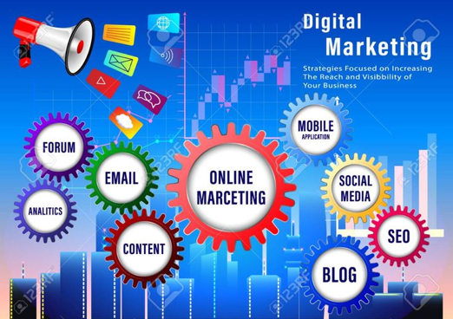
DIGITAL MARKETING TRAINING
SEO (Search Engine Optimization) – Learn techniques to improve a website's visibility on search engines like Google.
Social Media Marketing – Use social media platforms to promote products, engage customers, and build brand awareness.
Content Marketing – Create valuable and relevant content to attract and retain customers.
Email Marketing – Design and manage email campaigns to communicate with customers and promote products or services.

Slide 8
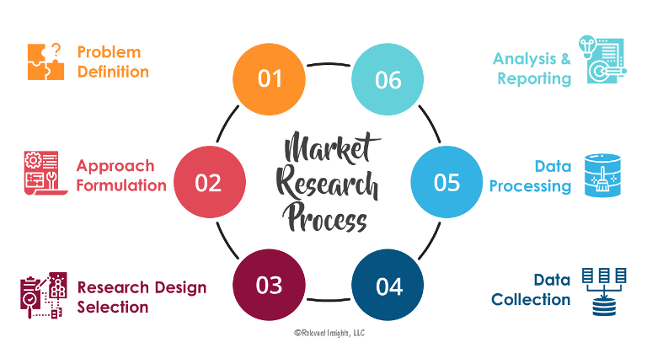
MARKET RESEARCH ACTIVITIES
Customer Surveys – Collect customer feedback to understand their needs, preferences, and satisfaction levels.
Competitor Analysis – Study competitors' products, pricing, and marketing strategies to identify market opportunities.
Data Collection – Gather relevant market and customer data for informed decision-making.
Report Preparation – Analyse research findings and prepare reports to support marketing strategies and business decisions.

Slide 9
PROJECT ASSIGNMENTS
Marketing Campaign Analysis – Evaluate the performance and effectiveness of marketing campaigns to identify areas for improvement.
Product Promotion Strategies – Develop and implement strategies to promote products and increase customer interest.
Social Media Engagement Projects – Create and manage social media activities to improve customer interaction and brand visibility.
Customer Feedback Analysis – Analyse customer reviews and feedback to enhance products, services, and customer satisfaction.

Slide 10
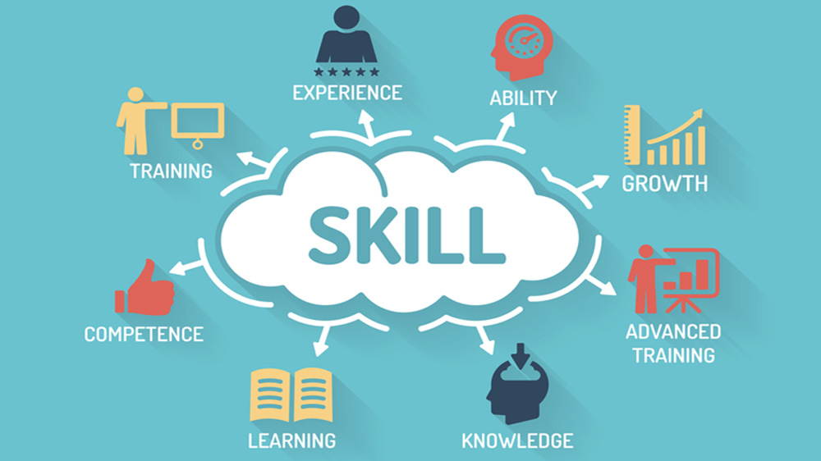
SKILL DEVELOPMENT
Analytical Skills – Learn to interpret market data and make informed marketing decisions.
Communication Skills – Improve verbal and written communication for professional and customer interactions.
Presentation Skills – Develop the ability to present ideas, reports, and marketing plans effectively.
Teamwork and Leadership – Build collaboration and leadership skills by working on group projects and assignments.

Slide 11

MENTORSHIP PROGRAM
Guidance from Experienced Professionals – Receive practical advice and industry insights from marketing experts.
Regular Mentoring Sessions – Participate in scheduled sessions to discuss progress, challenges, and learning objectives.
Career Counselling – Get career guidance on job opportunities, skill development, and professional growth in the marketing field.

Slide 12
LEARNING OUTCOMES
Practical Marketing Knowledge
  Interns gain hands-on experience in marketing concepts, tools, and strategies used in real business environments.
Improved Confidence
  Working on projects, interacting with professionals, and presenting ideas helps interns become more confident in their abilities.
Industry Readiness
  Interns understand workplace expectations, industry practices, and professional standards, preparing them for future job roles.
Professional Development
  The internship helps develop essential skills such as communication, problem-solving, teamwork, and leadership, contributing to overall career growth.

Slide 13
CAREER OPPORTUNITIES
AFTER INTERNSHIP
Marketing Executive
  Responsible for planning and implementing marketing activities to promote products or services and increase sales.
Digital Marketing Specialist
  Manages online marketing campaigns, including SEO, social media marketing, email marketing, and website promotion to improve brand visibility.
Brand Manager
  Develops and maintains a company's brand image by creating strategies that enhance customer perception and brand value.
Market Research Analyst
  Collects and analyzes market data, customer preferences, and industry trends to help businesses make informed decisions.
Sales and Marketing Associate
  Supports sales and marketing efforts by interacting with customers, promoting products, and assisting in achieving business targets.

Slide 14

CONCLUSION
A structured internship program in a marketing organization provides students with practical experience, industry exposure, and professional skill development. It helps interns apply their academic knowledge in real-world marketing activities while improving their confidence and career readiness. Such programs benefit both students and organizations by creating opportunities for learning, talent development, and future employment in the marketing field.

