Slide 1
STRUCTURED INTERNSHIP PROGRAM IN LAW FIRM
Submitted by:- Unnati Chaurasia
Submitted to:- Sashwat Singhal

Slide 2
INTRODUCTION
Meaning of a Structured Internship Program in the Legal Profession
A structured internship program is a well-organized training program for law students and aspiring legal professionals. It provides practical exposure to legal work under the supervision of experienced advocates. Interns learn about legal concepts, court procedures, case handling, legal drafting, and professional ethics, helping them understand how the legal system works in practice.
Importance of Practical Legal Training
Practical legal training is essential because it allows students to apply their theoretical knowledge in real-life legal situations. Through activities such as legal research, attending court proceedings, and assisting advocates, interns develop practical skills, improve their understanding of laws and procedures, and build confidence for their future legal careers.

Slide 3
OBJECTIVES
1. Develop Legal Knowledge
The internship helps interns gain a deeper understanding of various laws, legal principles, and judicial procedures. It enables them to learn how legal concepts are applied in real cases and improves their knowledge of the legal system.
2. Gain Practical Exposure
Interns receive hands-on experience by participating in activities such as legal drafting, attending court proceedings, conducting legal research, and assisting in case preparation. This practical exposure helps them understand the day-to-day work of legal professionals.
3. Enhance Professional Skills
The program develops essential professional skills, including effective communication, legal research, analytical and problem-solving abilities, time management, and professional ethics. These skills are important for building a successful career in the legal field.

Slide 4
DURATION AND STRUCTURE
1. Internship Period (4–8 Weeks)
The structured legal internship is generally conducted for a period of 4 to 8 weeks, depending on the advocate's office, law firm, or legal organization. During this period, interns are given practical exposure to various legal activities and are guided by experienced legal professionals. The duration is designed to provide sufficient time for learning and skill development.
2. Weekly Schedule and Assigned Tasks
Interns are assigned different tasks each week to ensure systematic learning. These tasks may include conducting legal research, drafting legal documents, attending court hearings, preparing case summaries, and assisting advocates in case-related work. A planned weekly schedule helps interns gain practical experience while developing their legal and professional skills in an organized manner.

Slide 5
AREAS OF LEGAL EXPOSURE
Civil Law
Deals with disputes related to property, contracts, and personal rights.
Criminal Law
Covers offences, criminal trials, and legal procedures for crimes.
Corporate Law
Involves company-related legal matters, compliance, and business regulations.
Family Law
Deals with marriage, divorce, child custody, maintenance, and inheritance matters.
Constitutional Law
Focuses on fundamental rights, constitutional provisions, and the functioning of government institutions.

Slide 6
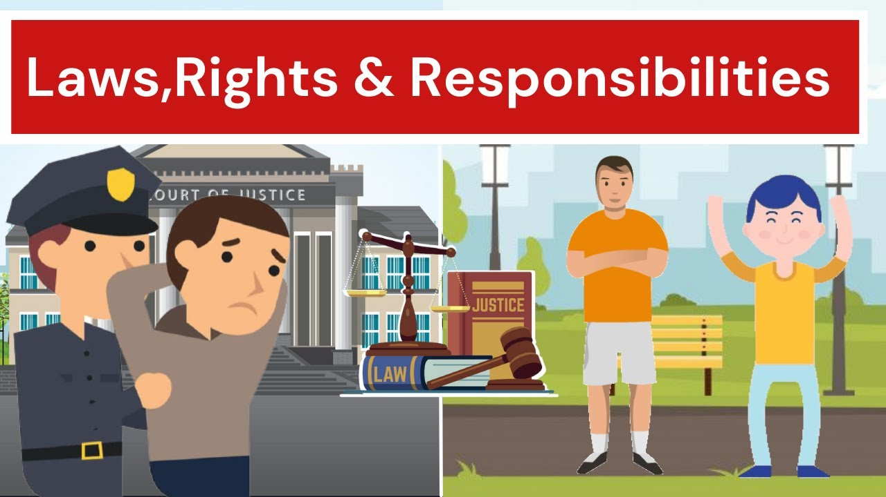
ROLES AND RESPONSIBILITIES
Legal Research
Researching laws, judicial precedents, and legal provisions relevant to cases.
Drafting Documents
Assisting in preparing legal notices, petitions, affidavits, and agreements.
Case Analysis
Studying case facts, identifying legal issues, and understanding legal arguments.
Assisting Advocates
Supporting advocates in court preparation, client meetings, and legal documentation.
These points are short, detailed, and suitable for explaining each PPT slide during a presentation.

Slide 7
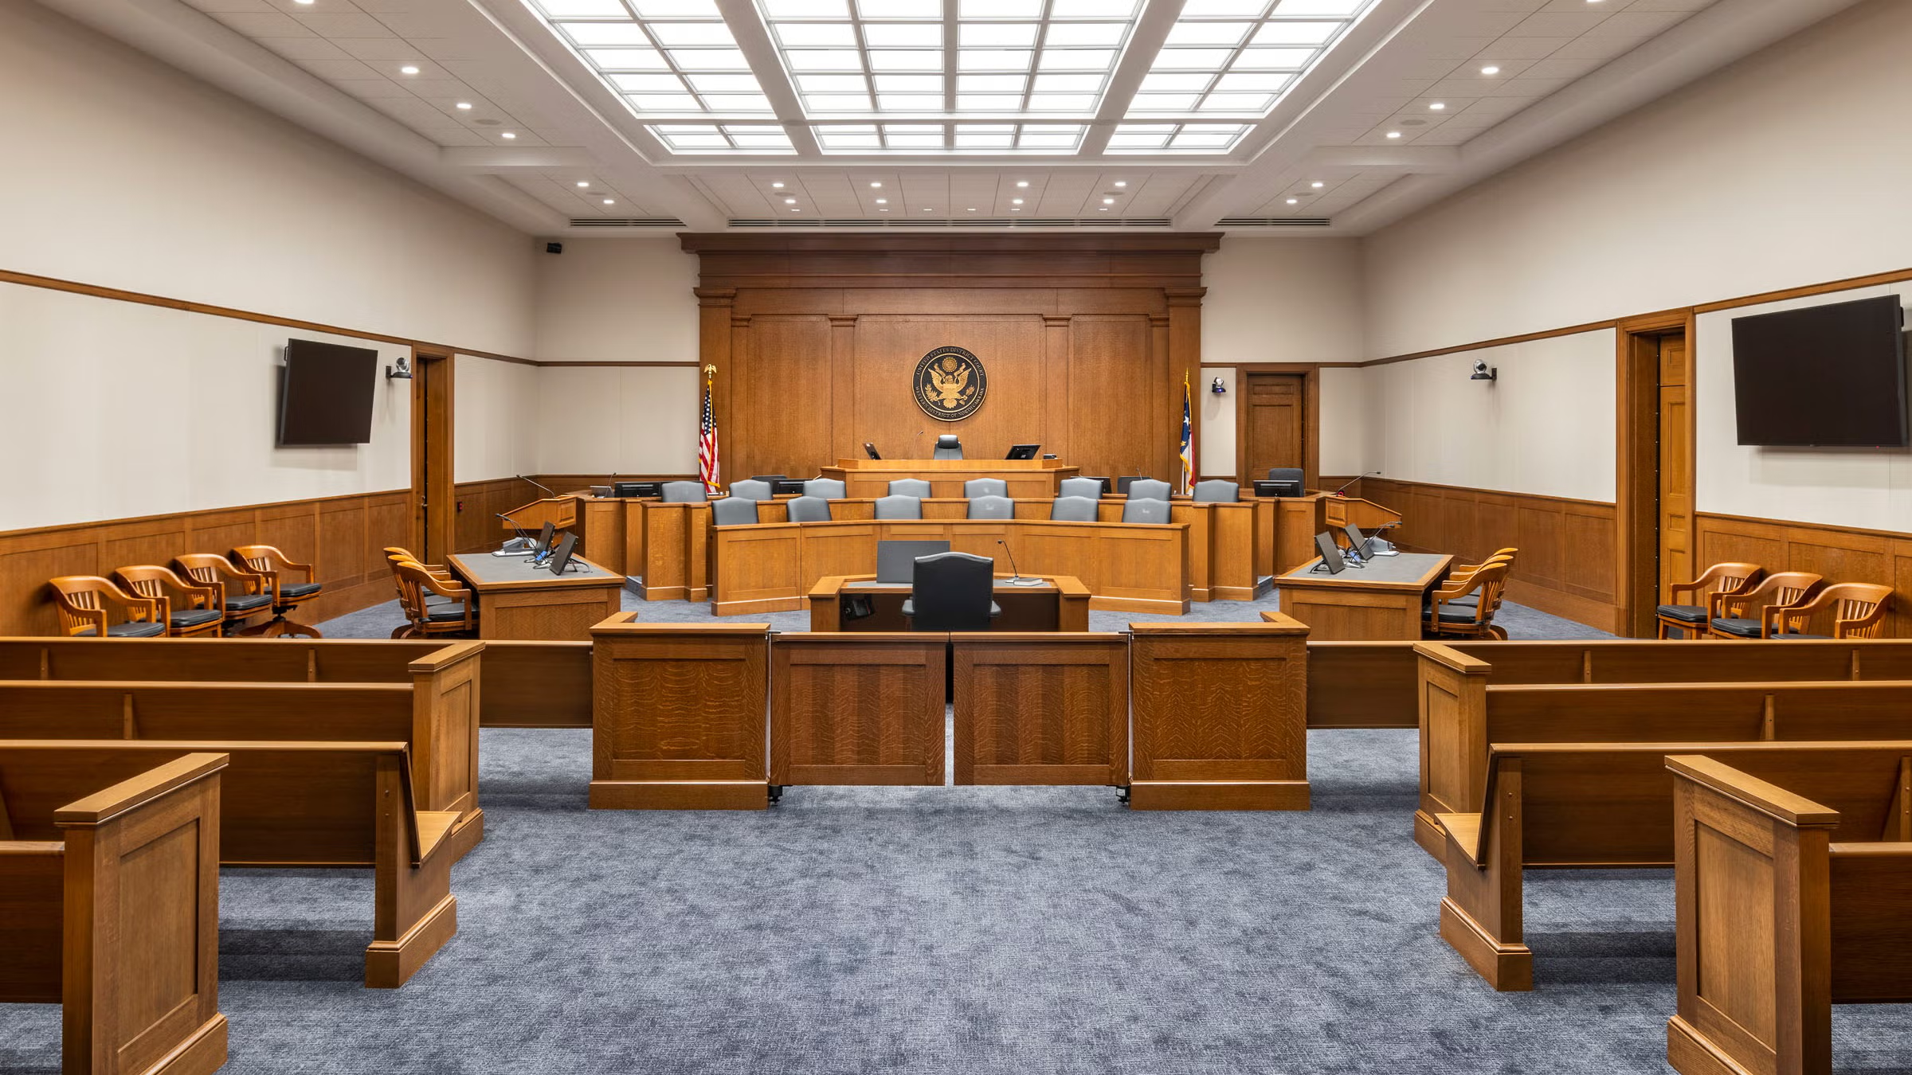
COURTROOM EXPOSURE
Attending Court Proceedings: Interns observe court hearings to understand how cases are argued and decided in a real courtroom setting.
Understanding Legal Procedures: They learn about filing procedures, court protocols, and the stages involved in legal proceedings.
Observing Client Interactions: Interns gain insight into how advocates communicate with clients, understand their concerns, and provide legal advice.

Slide 8
LEGAL DRAFTING SKILLS
Drafting Notices: Interns learn how to prepare legal notices used for formal communication in legal matters.
Petitions and Affidavits: They assist in drafting petitions and affidavits required for filing cases and making legal declarations.
Legal Opinions and Agreements: Interns learn to prepare legal opinions and draft agreements related to various legal issues and transactions.

Slide 9
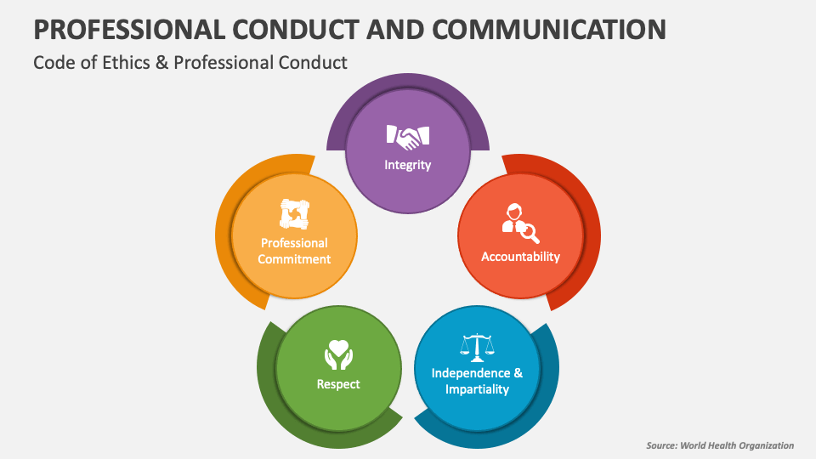
PROFESSIONAL AND ETHICAL CONDUCT
Client Confidentiality: Interns are expected to keep all client information confidential and maintain privacy at all times.
Professional Ethics: They learn to follow ethical standards such as honesty, integrity, and professionalism in legal practice.
Workplace Discipline: Interns are required to be punctual, responsible, and respectful in a professional legal environment.

Slide 10
LEARNING OUTCOMES
Practical Legal Experience: Interns gain hands-on experience by working on real legal matters and observing professional practices.
Better Understanding of Court Procedures: They develop a clear understanding of how courts function and how legal proceedings are conducted.
Improved Drafting and Research Skills: Regular involvement in legal drafting and research enhances their technical and professional competencies.

Slide 11

CONCLUSION
A structured internship program in the legal profession plays a vital role in preparing law students for their future careers. It combines theoretical knowledge with practical experience by providing exposure to courtroom proceedings, legal drafting, research work, and professional ethics. Through guided training under experienced advocates, interns develop essential legal and professional skills such as communication, analytical thinking, and time management. Overall, the program enhances legal understanding, builds confidence, and equips aspiring legal professionals with the practical competencies required for successful legal practice.

