Slide 1
TOPIC:
INCOME TAX RETURN
SUBMITTED BY: SUBMITTED TO:
SANIYA USMANI SHASHWAT SINGHAL

Slide 2
Introduction
What is an Income Tax Return (ITR)?
An Income Tax Return (ITR) is a form used by taxpayers to report their income, deductions, taxes paid, and tax liability to the Income Tax Department.
Filing an ITR is mandatory for eligible taxpayers under the Income-tax Act, 1961.
Different ITR forms are prescribed based on the type of taxpayer and source of income.

Slide 3
Types of ITR Forms
There are seven ITR forms:
ITR-1 (Sahaj)
ITR-2
ITR-3
ITR-4 (Sugam)
ITR-5
ITR-6
ITR-7
ITR-V (Verification Form)

Slide 4
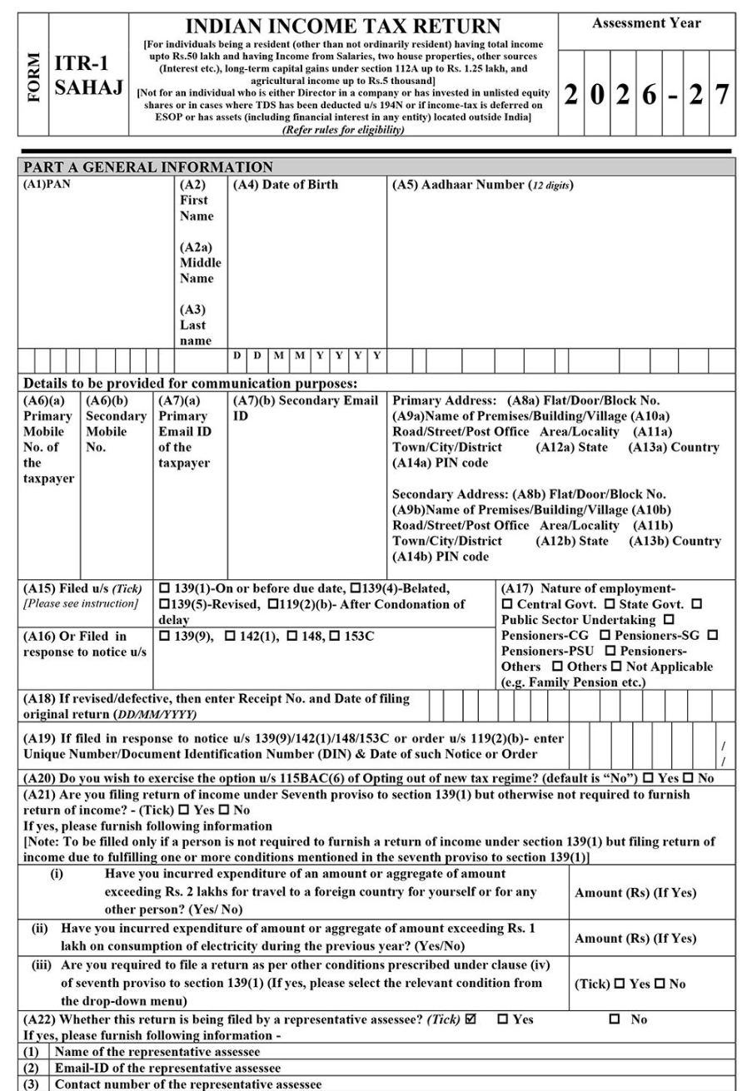
ITR-1 (Sahaj)
Who can file?
Resident Individuals having:
Income up to ₹50 lakh
Salary/Pension income
One house property
Other sources (excluding lottery, race horses)
Agricultural income up to ₹5,000
Cannot file if:
Income exceeds ₹50 lakh
Capital gains
Business or professional income
Foreign assets or foreign income

Slide 5
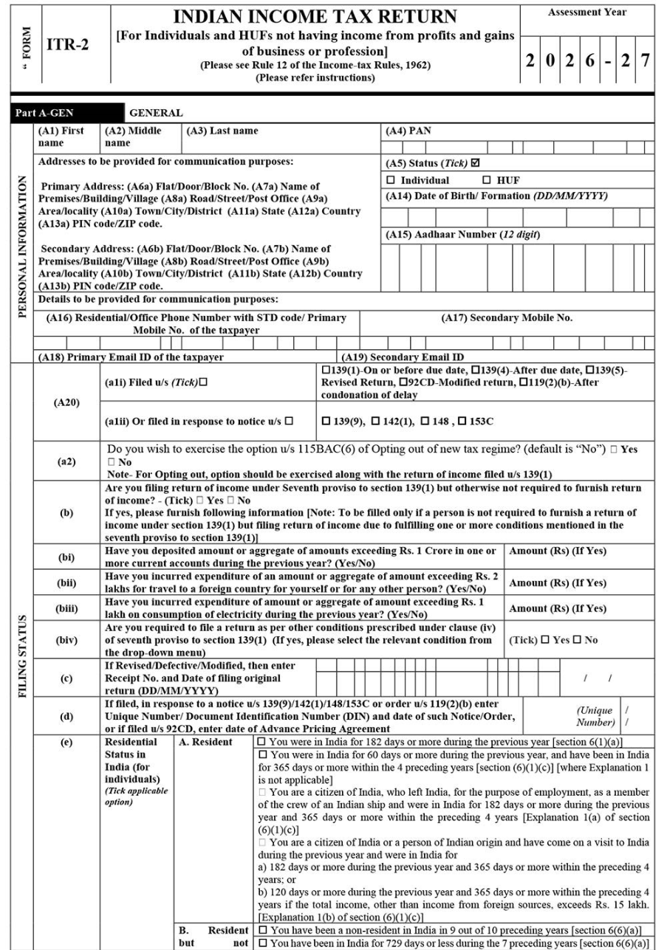
ITR-2
Applicable for:
Individuals and HUFs:
No business or professional income
Capital gains
More than one house property
Foreign income/assets
Income exceeding ₹50 lakh
Suitable for:
Investors
NRIs
Persons having capital gains

Slide 6
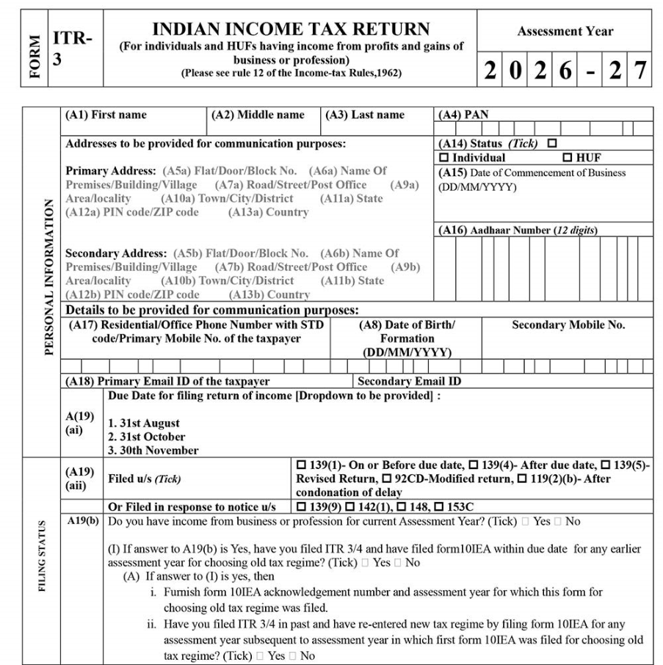
ITR-3
Applicable for:
Individuals and HUFs having:
Business income
Professional income
Income from partnership firm
Capital gains
Multiple income sources
Examples:
Doctors
Chartered Accountants
Lawyers
Consultants
Traders

Slide 7
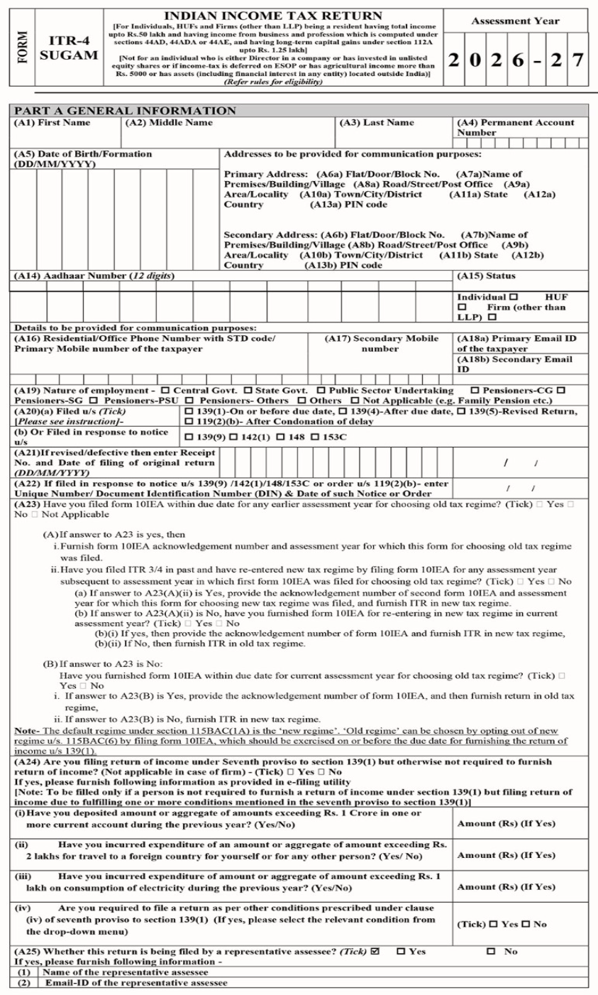
ITR-4 (Sugam)
Applicable for:
Resident Individuals, HUFs and Firms (other than LLP)
Eligible if:
Income up to ₹50 lakh
Presumptive taxation scheme
Business under applicable presumptive provisions
Professional income under applicable presumptive provisions
Not applicable for:
Companies
LLPs
Persons having foreign income/assets

Slide 8
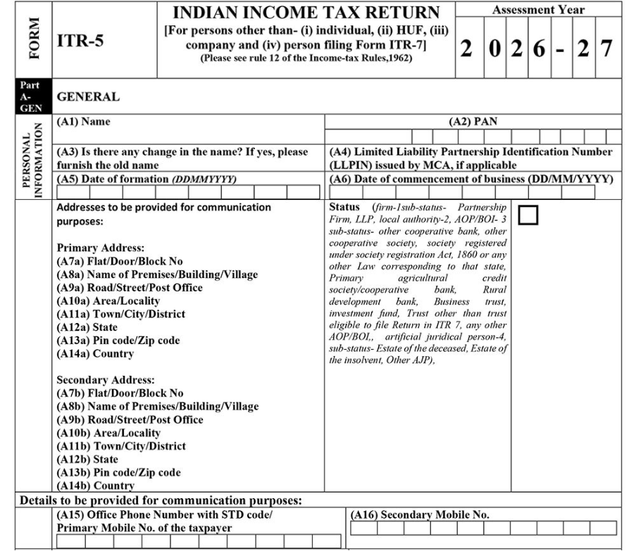
ITR-5
Applicable for:
Partnership Firms
LLPs
Association of Persons (AOP)
Body of Individuals (BOI)
Artificial Juridical Persons
Estate of deceased
Business trusts and investment funds (where applicable)
Not applicable for:
Individuals
Companies
Trusts filing ITR-7

Slide 9
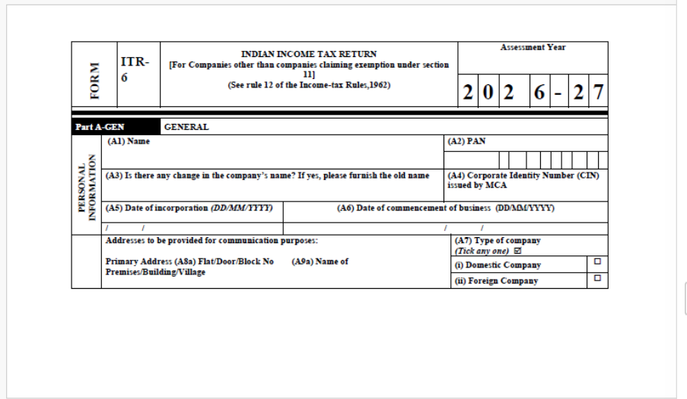
ITR-6
Applicable for:
Companies other than those claiming exemption under the provisions relating to charitable or religious purposes.
Filed by:
Private Limited Companies
Public Limited Companies
One Person Companies (OPCs)

Slide 10
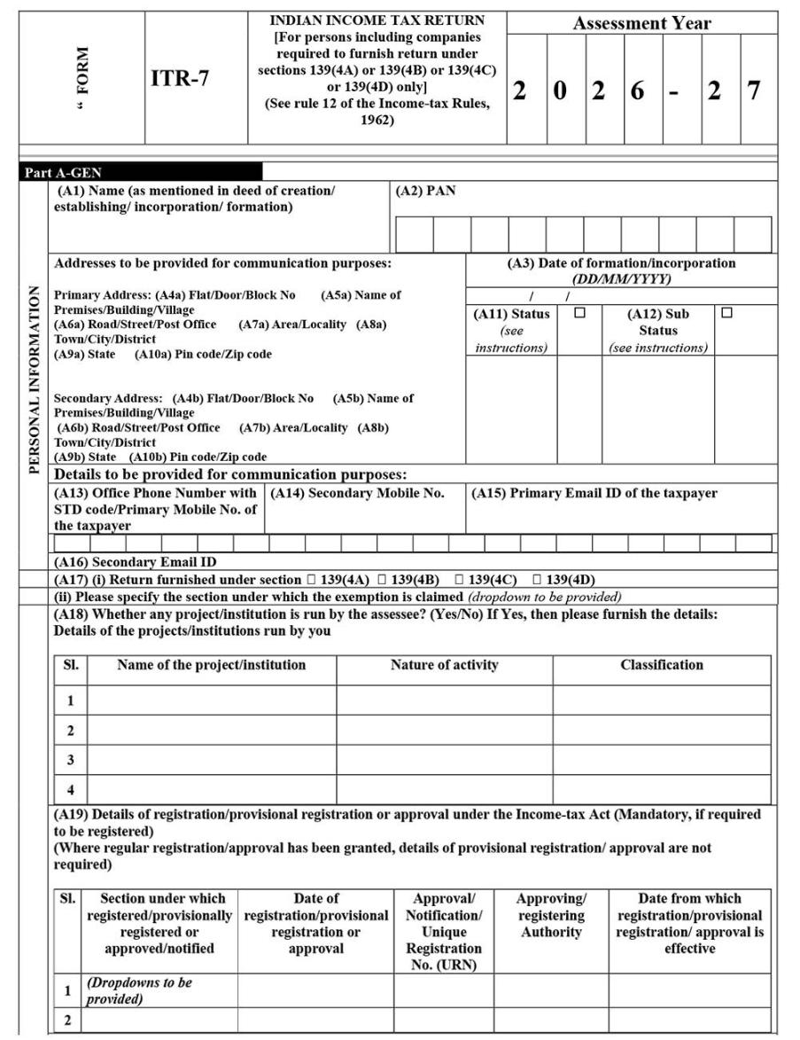
ITR-7
Applicable for:
Entities required to furnish returns under specific provisions of the Income-tax Act, such as:
Charitable Trusts
Religious Trusts
Political Parties
Educational Institutions
Hospitals
Research Associations
Other eligible institutions claiming exemption

Slide 11
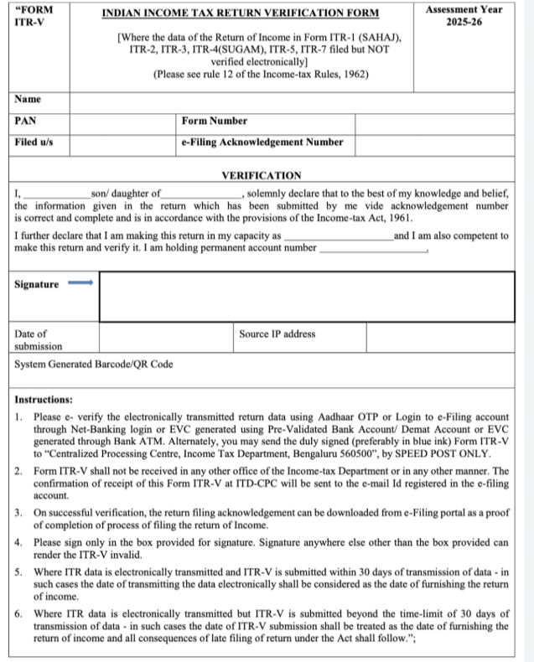
ITR-V (Income Tax Return Verification Form)
What is ITR-V?
Verification form generated after filing an ITR without using a digital signature or certain electronic verification methods.
Confirms that the return filed is authentic.
Verification methods:
Aadhaar OTP
Net Banking
Bank Account EVC
Demat Account EVC
Digital Signature Certificate (where applicable)
If the return is not e-verified immediately, ITR-V may need to be submitted as per the Income Tax Department's prescribed process.

Slide 12
COMPARISON CHART
Comparison of ITR Forms
Form | Applicable To | Main Income
ITR-1 | Resident Individuals | Salary, One House Property
ITR-2 | Individuals/HUF | Capital Gains, Multiple House Properties
ITR-3 | Individuals/HUF | Business & Profession
ITR-4 | Individuals/HUF/Firms | Presumptive Business Income
ITR-5 | LLP, Firms, AOP, BOI | Business Income
ITR-6 | Companies | Company Income
ITR-7 | Trusts & Institutions | Exempt Income

Slide 13
Benefits of Filing ITR
Legal compliance
Easy loan and visa processing
Claim tax refunds
Carry forward eligible losses
Proof of income
Better financial record

Slide 14
Conclusion
Selecting the correct ITR form is essential for accurate tax filing.
Filing the appropriate return helps ensure compliance with tax laws and reduces the chances of notices due to incorrect filing.
Taxpayers should choose the form based on their residential status, type of taxpayer, and sources of income.

