Slide 1
RESEARCH PROJECT REPORT IN FULFILMENT OF SUMMER INTERNSHIP PROJECT
TOPIC:
CORPORATE SOCIAL RESPONSIBILITY
(CSR)
SUBMITTED BY: SUBMITTED TO:
Saniya Usmani Shashwat Singhal

Slide 2
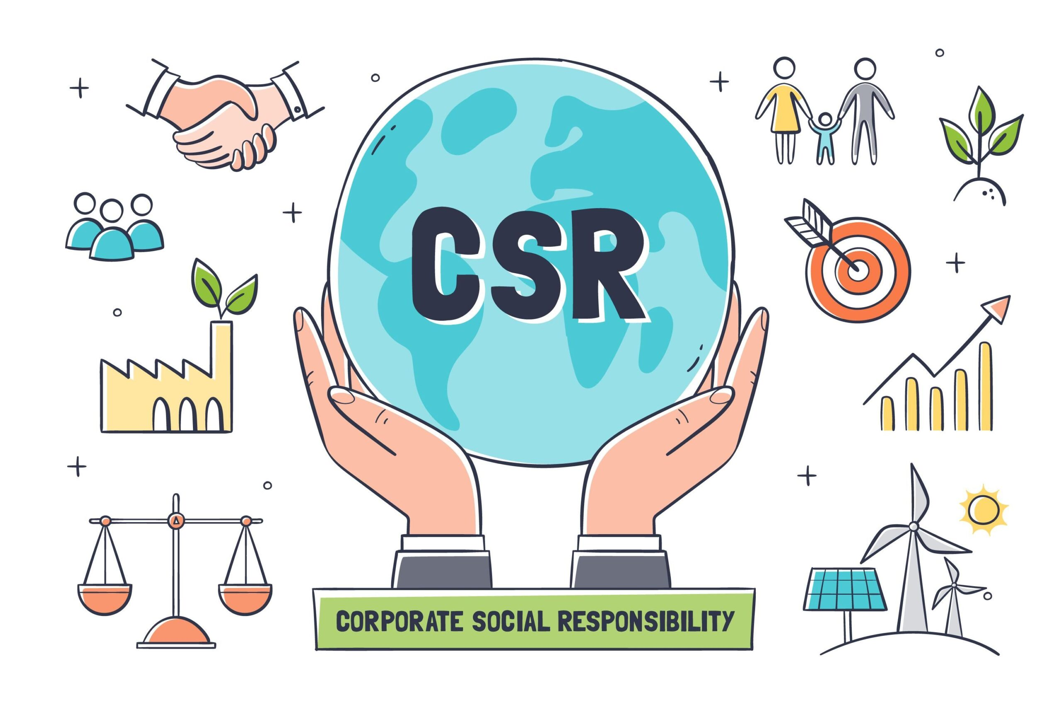
What is CSR?
Corporate Social Responsibility (CSR) is a company's commitment to operate ethically.
It involves contributing to economic development while improving the quality of life of employees, communities, and society.
CSR focuses on balancing People, Planet, and Profit.

Slide 3
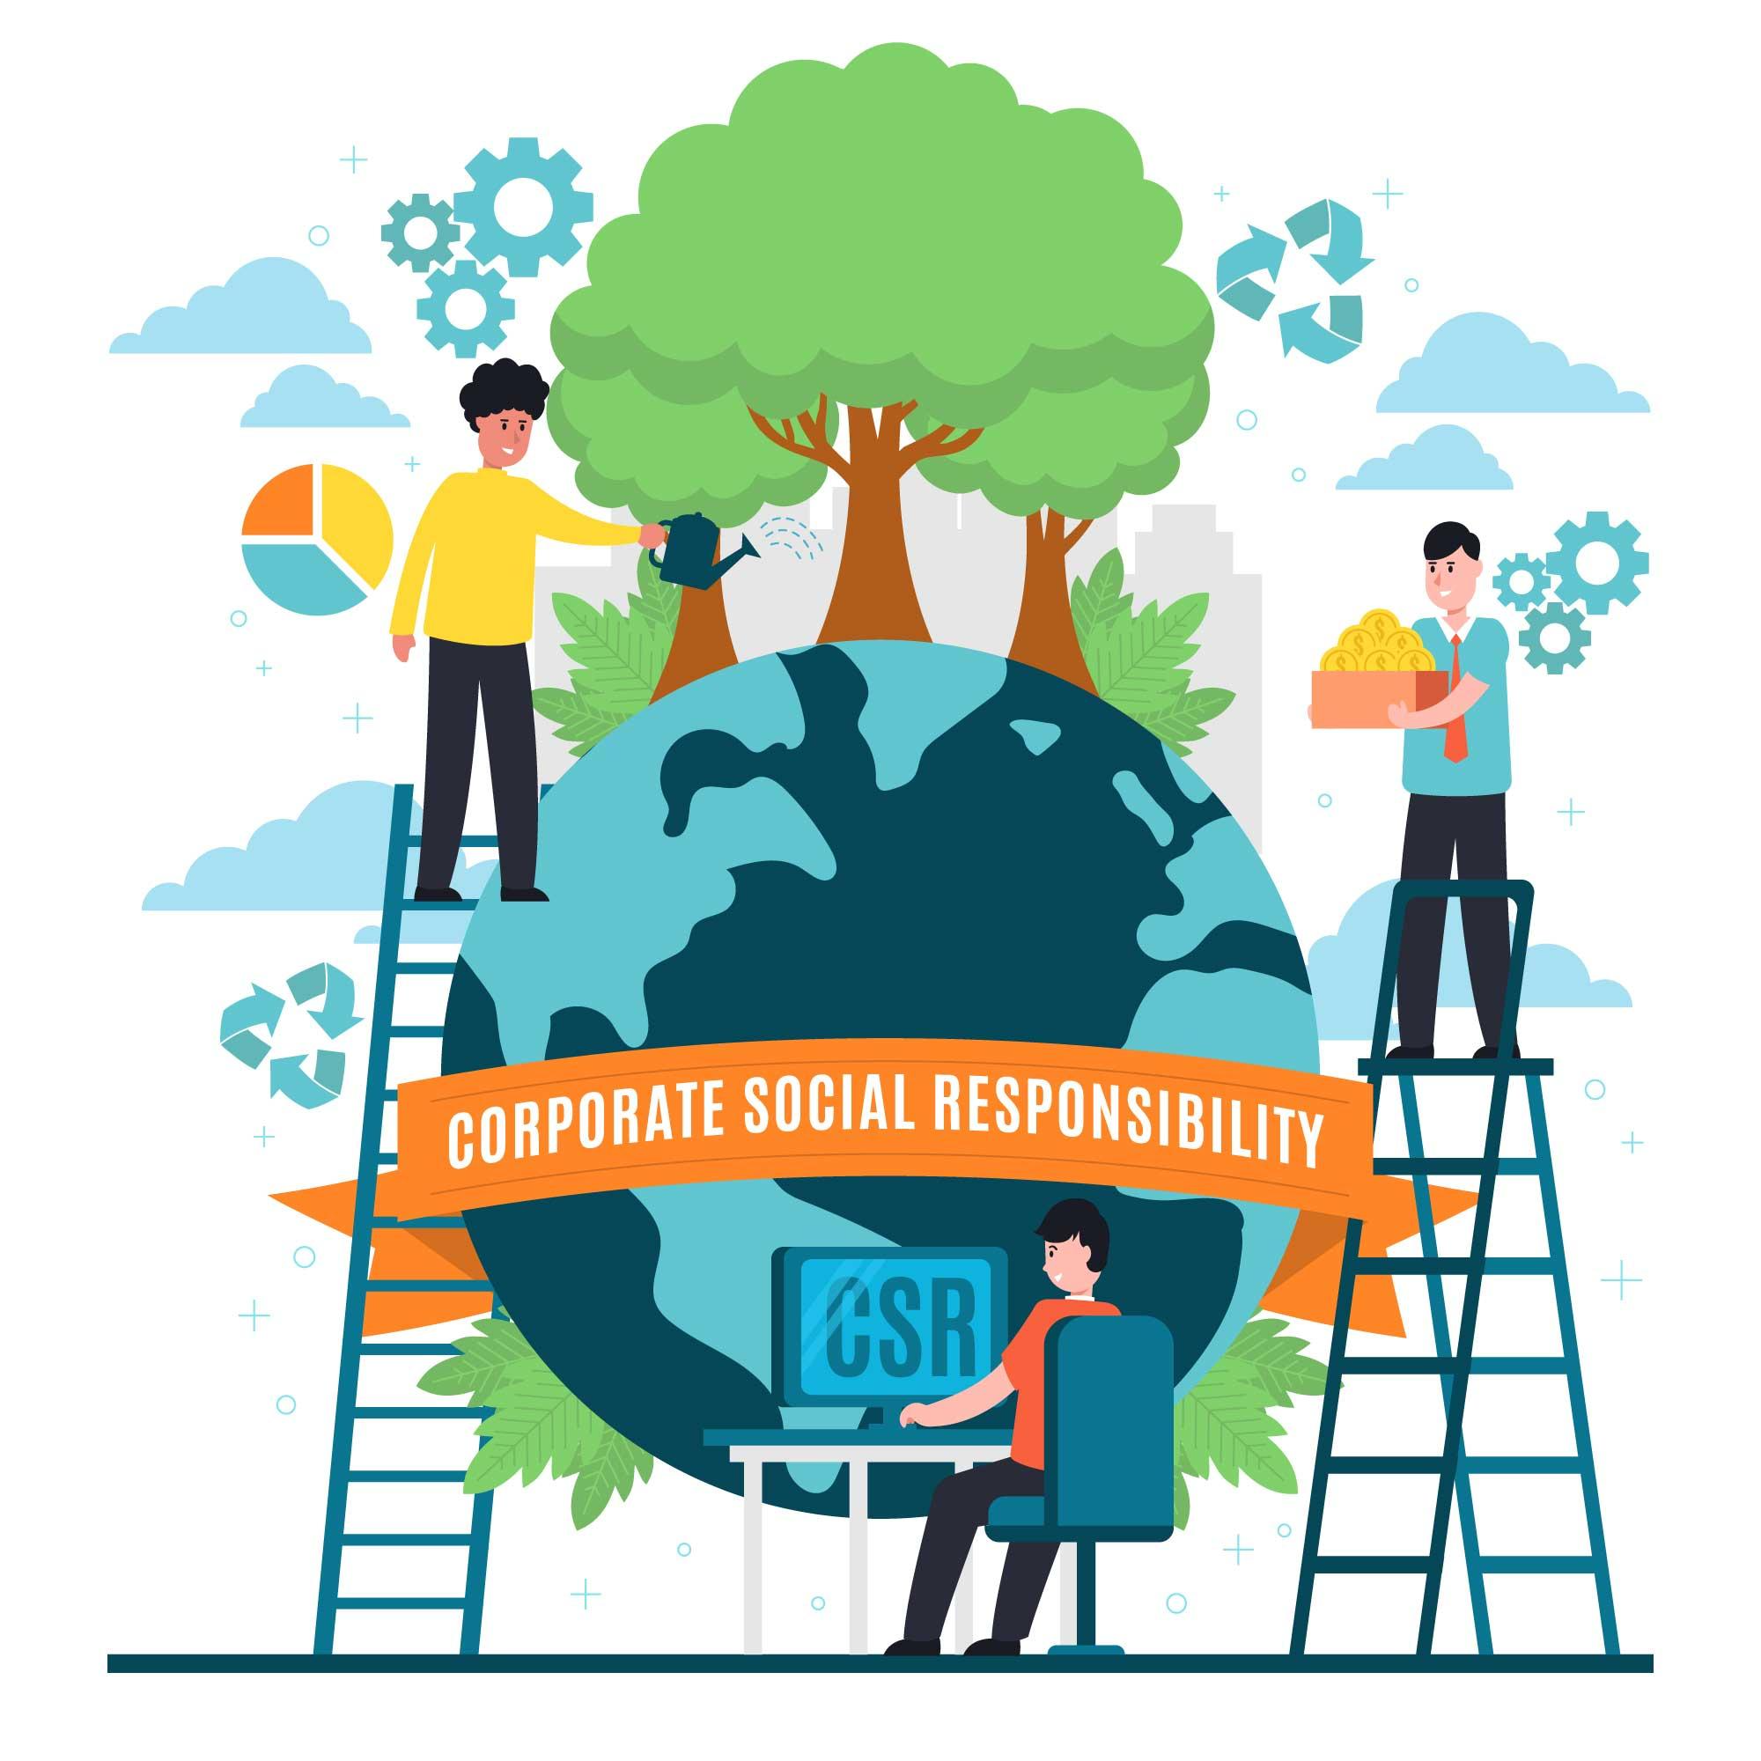
Objectives of CSR
Promote ethical business practices.
Protect the environment.
Improve community welfare.
Enhance employee well-being.
Build customer trust and brand reputation.
Support sustainable development.

Slide 4
Types of CSR
1. Environmental Responsibility
Reducing pollution
Recycling and waste management
Using renewable energy
2. Ethical Responsibility
Fair treatment of employees
Honest business practices
Equal opportunities
3. Philanthropic Responsibility
Donations to charities
Educational support
Healthcare initiatives
4. Economic Responsibility
Sustainable business growth
Creating jobs
Responsible investments

Slide 5
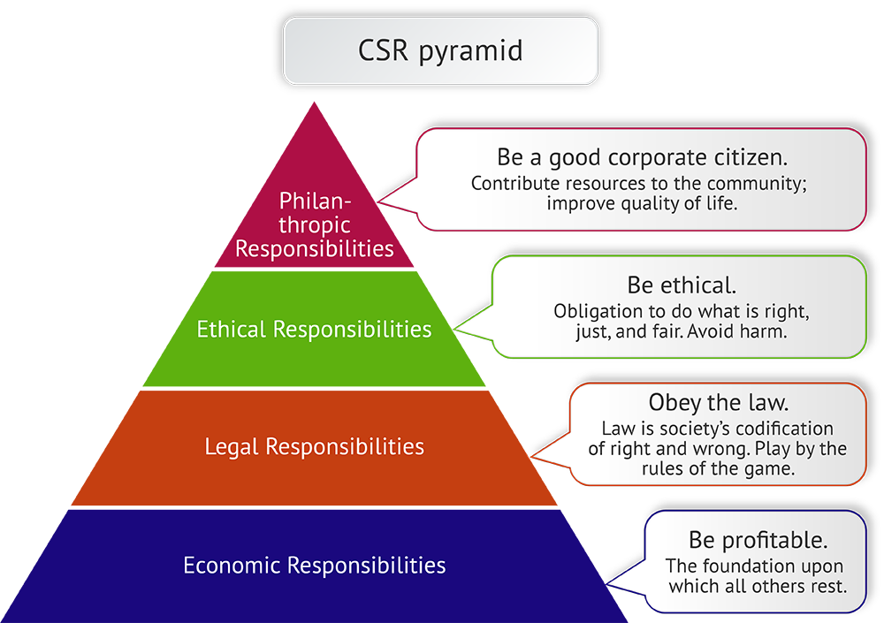
CSR PYRAMID

Slide 6
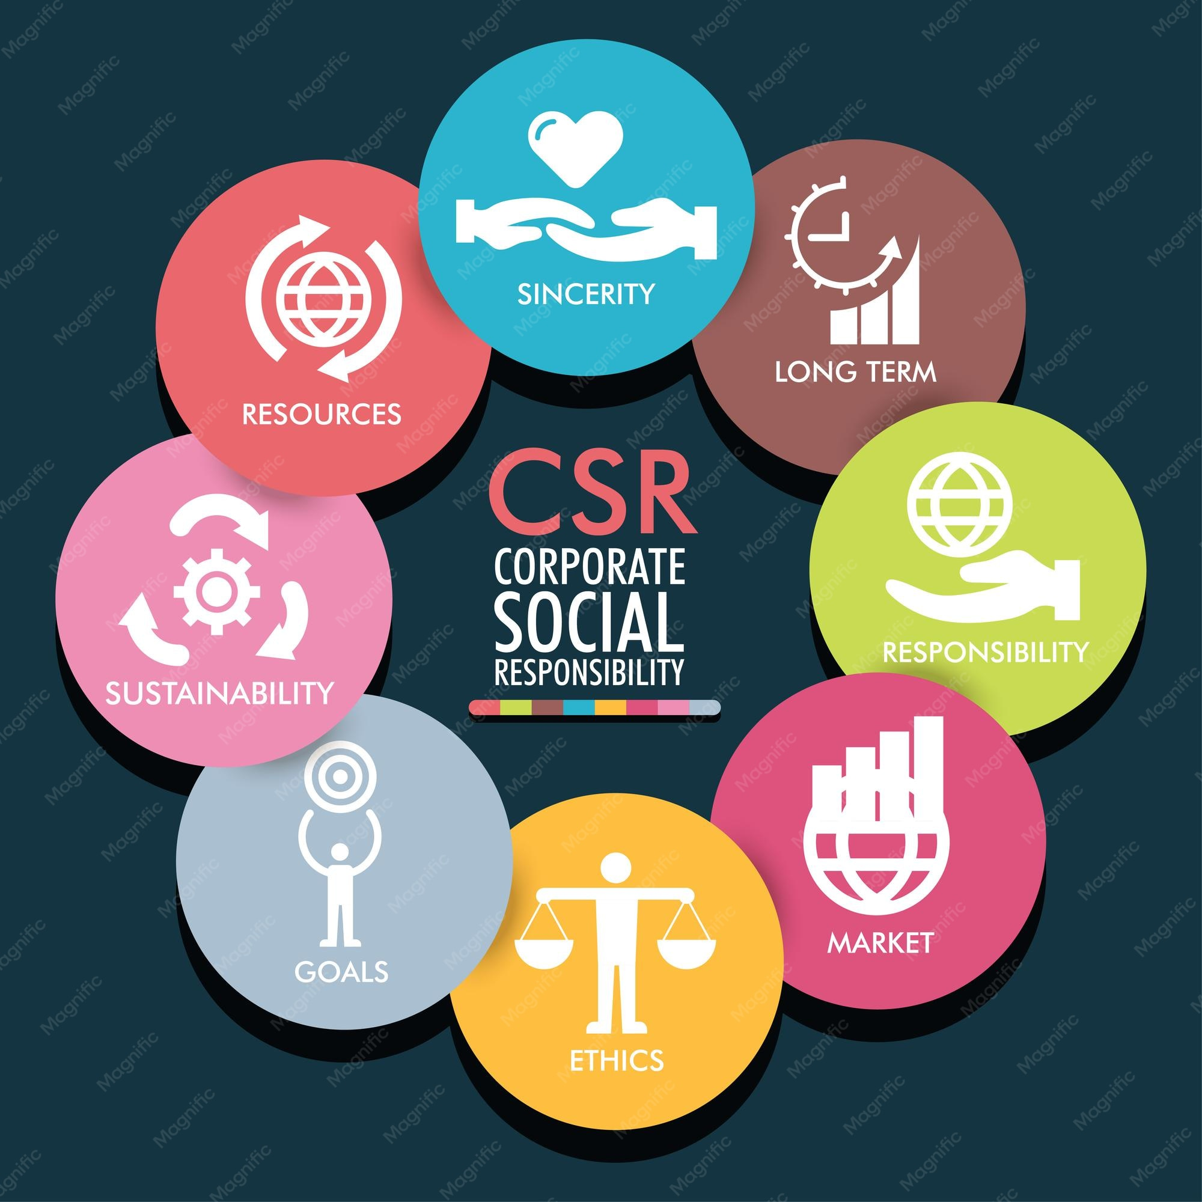
CSR in India
Under the Companies Act, 2013, eligible companies must spend at least 2% of their average net profits from the previous three financial years on CSR activities.
Common CSR areas:
  Education
  Healthcare
  Women empowerment
  Rural development
  Environmental sustainability
  Skill development

Slide 7
Section 135 of the Companies Act, 2013
Section 135 of the Companies Act, 2013 makes Corporate Social Responsibility (CSR) mandatory for certain companies in India. It applies to companies that satisfy any one of the following criteria during the immediately preceding financial year:
Net worth of ₹500 crore or more, or
Turnover of ₹1,000 crore or more, or
Net profit of ₹5 crore or more.
Eligible companies must:
Constitute a CSR Committee of the Board (where applicable).
Formulate and recommend a CSR Policy.
Ensure that the company spends at least 2% of the average net profits made during the three immediately preceding financial years on eligible CSR activities.
Monitor the implementation of CSR projects and disclose CSR details in the Board's Report and on the company's website, where applicable.

Slide 8
Schedule VII of the Companies Act, 2013
Schedule VII specifies the activities that qualify as Corporate Social Responsibility (CSR). Some major areas include:
Eradicating hunger, poverty, and malnutrition.
Promoting healthcare and sanitation.
Promoting education, including vocational and special education.
Promoting gender equality and empowering women.
Ensuring environmental sustainability and ecological balance.
Protection of national heritage, art, and culture.
Support for armed forces veterans, war widows, and their dependents.
Promotion of rural sports, nationally recognized sports, Paralympic sports, and Olympic sports.
Contributions to approved government relief and development funds.
Rural development and slum area development projects.
Disaster management, including relief, rehabilitation, and reconstruction.
These provisions ensure that eligible companies contribute to the social, economic, and environmental development of the country through structured and accountable CSR initiatives.

Slide 9
Benefits of CSR
For Businesses
Better brand image
Higher profits
Increased customer loyalty
Competitive advantage
For Society
Better education
Improved healthcare
Environmental conservation
Community development

Slide 10
Challenges of CSR
High implementation costs.
Measuring CSR impact.
Balancing profit with social responsibility.
Lack of awareness.
Ensuring transparency and accountability.

Slide 11
Examples of CSR
Tata Group – Education, healthcare, and rural development.
Infosys – Scholarships, digital education, and sustainability.
Microsoft – Carbon reduction and digital skills programs.
Unilever – Sustainable sourcing and waste reduction.

Slide 12
Conclusion
CSR helps businesses become socially and environmentally responsible.
It benefits companies, employees, customers, and society.
Sustainable business practices lead to long-term growth and positive social impact.

